Slide 1

University of Central Florida COP 3330 Object Oriented Programming

Slide 2
Exception Handling

Slide 3
Exception Handling
Exception
Short for “exceptional event”
A problem that occurs during program execution that disrupts the normal flow of instructions
the program/Application terminates abnormally, which is not recommended, therefore these exceptions are to be handled.
An exception can occur for many different reasons, below given are some scenarios where exception occurs.
A user has entered invalid data.
A file that needs to be opened cannot be found.
A network connection has been lost in the middle of communications or the JVM has run out of memory.
Some of these exceptions are caused by user error, others by programmer error, and others by physical resources that have failed in some manner.
Based on these we have three categories of Exceptions you need to understand them to know how exception handling works in Java

Slide 4
Exception Handling
Checked exceptions: A checked exception is an exception that occurs at the compile time, these are also called as compile time exceptions. These exceptions cannot simply be ignored at the time of compilation, the Programmer should take care of (handle) these exceptions.
Note: Since the methods read() and close() of FileReader class throws IOException, you can observe that compiler notifies to handle IOException, along with FileNotFoundException.

Slide 5
Exception Handling
Unchecked exceptions: An Unchecked exception is an exception that occurs at the time of execution, these are also called as Runtime Exceptions, these include programming bugs, such as logic errors or improper use of an API. runtime exceptions are ignored at the time of compilation.

Slide 6
Exception Handling
Errors: These are not exceptions at all, but problems that arise beyond the control of the user or the programmer. Errors are typically ignored in your code because you can rarely do anything about an error. For example, if a stack overflow occurs, an error will arise. They are also ignored at the time of compilation.

Slide 7
Exception Handling
Exception Hierarchy
All exception classes are subtypes of the java.lang.Exception class.
The exception class is a subclass of the Throwable class.
Other than the exception class there is another subclass called Error which is derived from the Throwable class.
Errors
not normally trapped from the Java programs.
These conditions normally happen in case of severe failures, which are not handled by the java programs.
Errors are generated to indicate errors generated by the runtime environment.
Example : JVM is out of Memory.
Normally programs cannot recover from errors

Slide 8
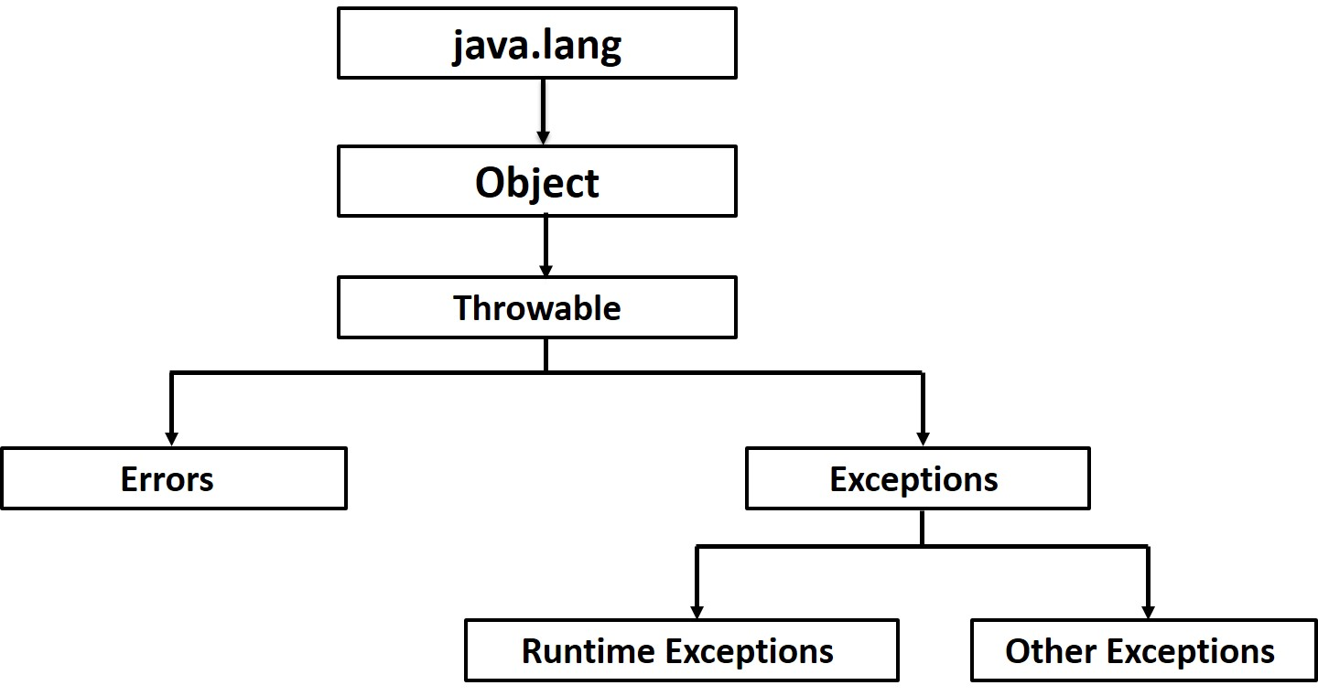
Exception Handling
Exception Hierarchy
The Exception class has two main subclasses: IOException class and RuntimeException Class.

Slide 9
Exception Handling
Exceptions Methods
Following is the list of important medthods available in the Throwable class
public String getMessage()Returns a detailed message about the exception that has occurred. This message is initialized in the Throwable constructor.
public Throwable getCause()Returns the cause of the exception as represented by a Throwable object.
public String toString()Returns the name of the class concatenated with the result of getMessage()
public void printStackTrace()Prints the result of toString() along with the stack trace to System.err, the error output stream.
public StackTraceElement [] getStackTrace()Returns an array containing each element on the stack trace. The element at index 0 represents the top of the call stack, and the last element in the array represents the method at the bottom of the call stack.
public Throwable fillInStackTrace()Fills the stack trace of this Throwable object with the current stack trace, adding to any previous information in the stack trace.

Slide 10
Exception Handling
Exception
When the error occurs within a method the method creates an object and hands it off to the runtime system, called an exception object
Exception object
Contains information about the error
Type
State of the program
Throwing an exception
The hand off of the created object to the runtime system is called throwing an exception

Slide 11
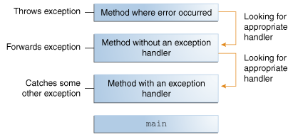
Exception Handling
The runtime system attempts to find within an ordered list of methods that were called prior to the thrown exception to handle it, called the call stack

Slide 12
Exception Handling
Stack trace example
Exception in thread "AWT-EventQueue-0" java.lang.NullPointerException
at userInterface.SearchFlight.populateDataArrays(SearchFlight.java:201)
at userInterface.SearchFlight.<init>(SearchFlight.java:75)
at userInterface.AirlineReservation$BookMenuAction.actionPerformed(AirlineReservation.java:168)
at javax.swing.AbstractButton.fireActionPerformed(AbstractButton.java:2018)
at javax.swing.AbstractButton$Handler.actionPerformed(AbstractButton.java:2341)

Slide 13
Exception Handling
try, catch, finally
try block
First step in constructing an exception handler
Encloses the code that might throw and exception
try
{
// code here
}
catch block
Must immediately follow the closing curly brace of a try block
Can have more than one catch block
Handles the type of exception indicated by its argument
Code than is executed when the exception handler is invoked

Slide 14
Exception Handling
Note the following:
A catch clause cannot exist without a try statement.
It is not compulsory to have finally clauses when ever a try/catch block is present.
The try block cannot be present without either catch clause or finally clause.
Any code cannot be present in between the try, catch, finally blocks.

Slide 15
Exception Handling
try, catch, finally
catch block
try
{
}
catch (FileNotFoundException e)
{
}
catch (IOException e)
{
}
catch (IOException|SQLException ex)
{
logger.log(ex);
throw ex;
}

Slide 16
Exception Handling
try, catch, finally
finally block
ALWAYS executed when the try block exits unless the JVM exits, a thread is interrupted or killed
Useful for cleaning up code, for example, closing a file
Can prevent resource leaks
try{}
catch{}
finally
{
if (out != null)
{
System.out.println("Closing PrintWriter"); out.close();
}
else
{
System.out.println("PrintWriter not open");
}
}

Slide 17
Exception Handling
Throwing an exception
If a method does not handle a checked exception, the method must declare it using the throws keyword. The throws keyword appears at the end of a method's signature.
You can throw an exception, either a newly instantiated one or an exception that you just caught, by using the throw keyword.
Try to understand the difference between throws and throw keywords, throws is used to postpone the handling of a checked exception and throw is used to invoke an exception explicitly.

Slide 18
Exception Handling
Throwing an exception
A method can declare that it throws more than one exception, in which case the exceptions are declared in a list separated by commas. For example, the following method declares that it throws a RemoteException and an InsufficientFundsException:

Slide 19
Exception Handling
User-defined Exceptions
You can create your own exceptions in Java. Keep the following points in mind when writing your own exception classes:
All exceptions must be a child of Throwable.
If you want to write a checked exception that is automatically enforced by the Handle or Declare Rule, you need to extend the Exception class.
If you want to write a runtime exception, you need to extend the RuntimeException class.

Slide 20
Questions
Any questions?

